Slide 1
ENG1003 Freshman Seminar for Engineering AAE Design of Path Planning Algorithm for Aircraft Operation Week 4: Additional Cost Area
Dr Li-Ta Hsu and Dr Weisong Wen
Assisted by
Man Hei CHENG (Melvin), Miss Hiu Yi HO (Queenie), Miss Yan Tung LEUNG (Nikki)

Slide 2

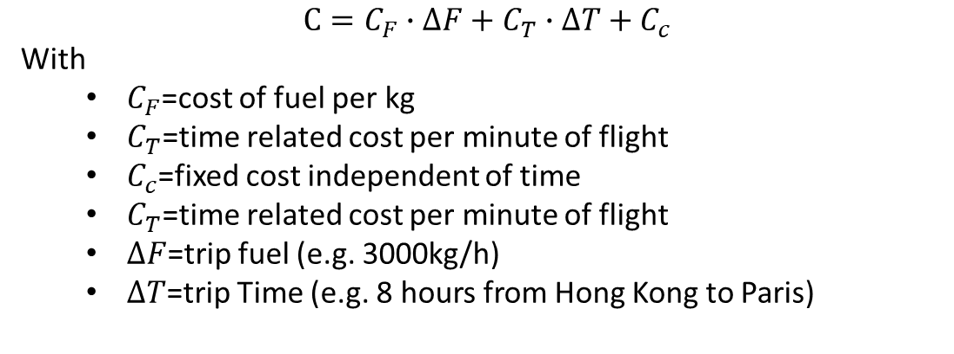
Flight planning considering trip cost
The fundamental rationale of the cost index concept is to achieve minimum trip cost by means of a trade-off between operating costs per hour and incremental fuel burn.
$$C=C_{F}∙∆F+C_{T}∙∆T+C_{c}$$
With
$C_{F}$=cost of fuel per kg
$C_{T}$=time related cost per minute of flight
$C_{c}$=fixed cost independent of time
$C_{T}$=time related cost per minute of flight
$∆F$=trip fuel (e.g. 3000kg/h)
$∆T$=trip Time (e.g. 8 hours from Hong Kong to Paris)
Can we consider this cost to our path planning to imitate the path planning for flights?

Slide 3
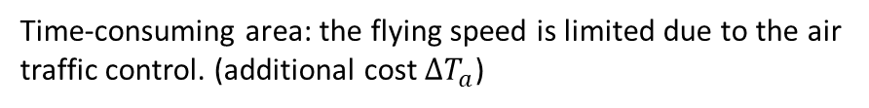
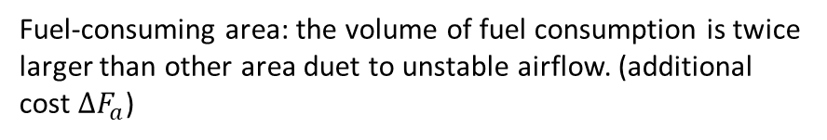
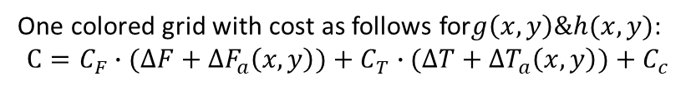
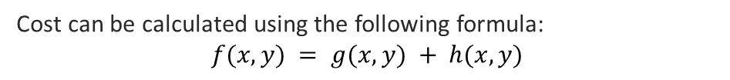

Flight planning considering trip cost
Fuel-consuming area: the volume of fuel consumption is twice larger than other area duet to unstable airflow. (additional cost $∆F_{a}$)
Time-consuming area: the flying speed is limited due to the air traffic control. (additional cost $∆T_{a}$)
Cost can be calculated using the following formula:
$$f(x,y) = g(x,y) + h(x,y)$$
One white grid with cost as follows for $g\left(x,y\right)\&h(x,y)$:
$$C=C_{F}∙∆F+C_{T}∙∆T+C_{c}$$
Start node
Goal node
One colored grid with cost as follows for$g\left(x,y\right)\&h(x,y)$:
$$C=C_{F}∙(∆F+∆F_{a}\left(x,y\right))+C_{T}∙(∆T+∆T_{a}\left(x,y\right))+C_{c}$$

Slide 4
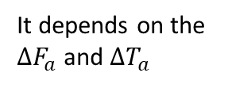
How we choose the routes ?
Fuel-consuming area: the volume of fuel consumption is twice larger than other area duet to unstable airflow. (additional cost $∆F_{a}$)
?
?
Time-consuming area: the flying speed is limited due to the air traffic control. (additional cost $∆T_{a}$)
Cost can be calculated using the following formula:
$$f(x,y) = g(x,y) + h(x,y)$$
One white grid with cost as follows for $g\left(x,y\right)\&h(x,y)$:
$$C=C_{F}∙∆F+C_{T}∙∆T+C_{c}$$
Start node
Goal node
One colored grid with cost as follows for$g\left(x,y\right)\&h(x,y)$:
$$C=C_{F}∙(∆F+∆F_{a}\left(x,y\right))+C_{T}∙(∆T+∆T_{a}\left(x,y\right))+C_{c}$$
It depends on the $∆F_{a}$ and $∆T_{a}$

Slide 5
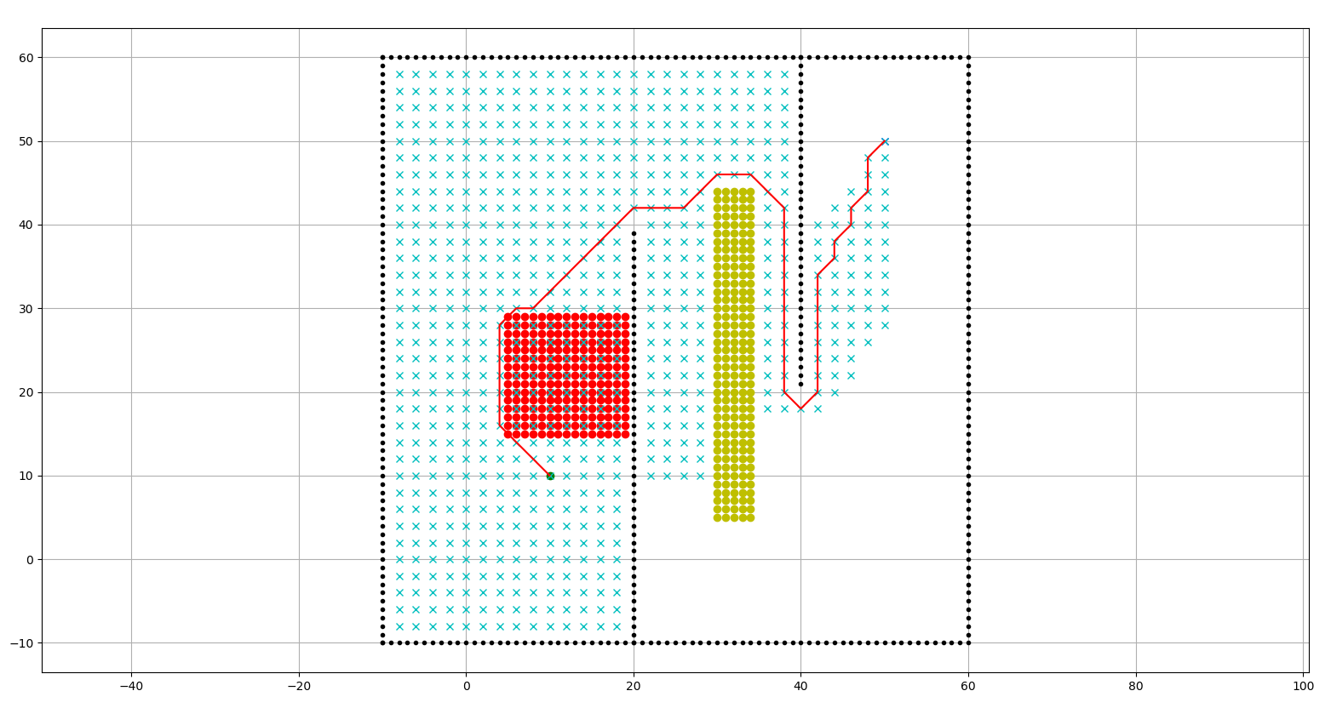
Example route planning
Fuel-consuming area
Time-consuming area
Trajectory
Avoiding the Fuel-consuming and time-consuming area if their cost is too high?

Slide 6
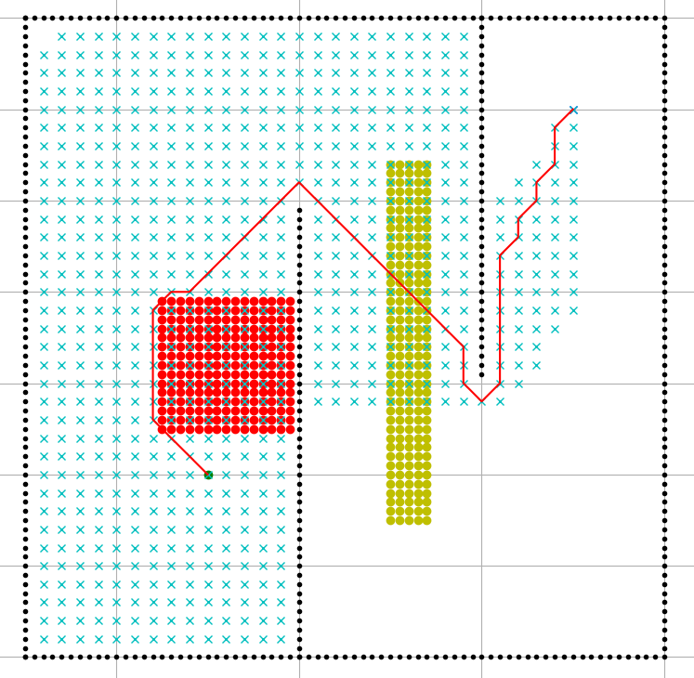
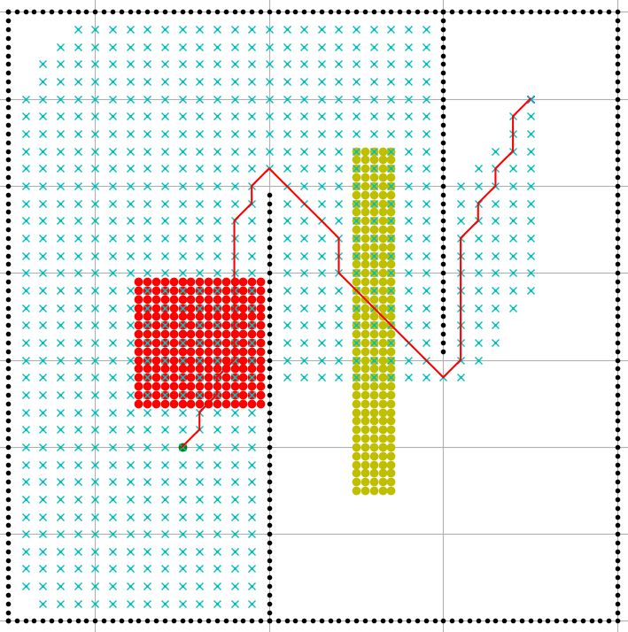
Example route planning
Go through the fuel-consuming and time-consuming area if their additional cost is quite small?

Slide 7
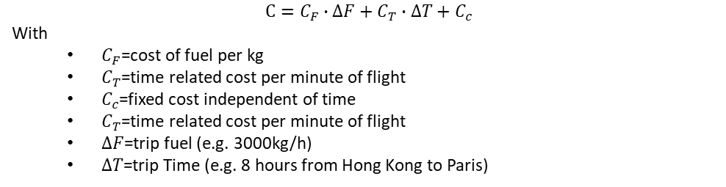
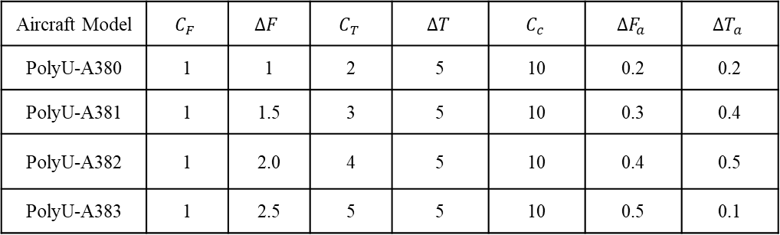
Design your route
Aircraft Model | $$C_{F}$$ | $$∆F$$ | $$C_{T}$$ | $$∆T$$ | $$C_{c}$$ | $$∆F_{a}$$ | $$∆T_{a}$$
PolyU-A380 | 1 | 1 | 2 | 5 | 10 | 0.2 | 0.2
PolyU-A381 | 1 | 1.5 | 3 | 5 | 10 | 0.3 | 0.4
PolyU-A382 | 1 | 2.0 | 4 | 5 | 10 | 0.4 | 0.5
PolyU-A383 | 1 | 2.5 | 5 | 5 | 10 | 0.5 | 0.1
$$C=C_{F}∙∆F+C_{T}∙∆T+C_{c}$$
With
$C_{F}$=cost of fuel per kg
$C_{T}$=time related cost per minute of flight
$C_{c}$=fixed cost independent of time
$C_{T}$=time related cost per minute of flight
$∆F$=trip fuel (e.g. 3000kg/h)
$∆T$=trip Time (e.g. 8 hours from Hong Kong to Paris)

